Slide 1
Apprenticeships – Where are we now? Professor Sharon Green

Slide 2
Key questions
Do employers use apprentices to address skills issues?
Are there infrastructural issues relating to the availability of apprenticeships that are creating barriers?
To what extent employers support the new policy of apprenticeships in England?

Slide 3
Apprenticeships -like a cream egg!

Slide 4
Partners in Apprenticeships at NCFM

Slide 5
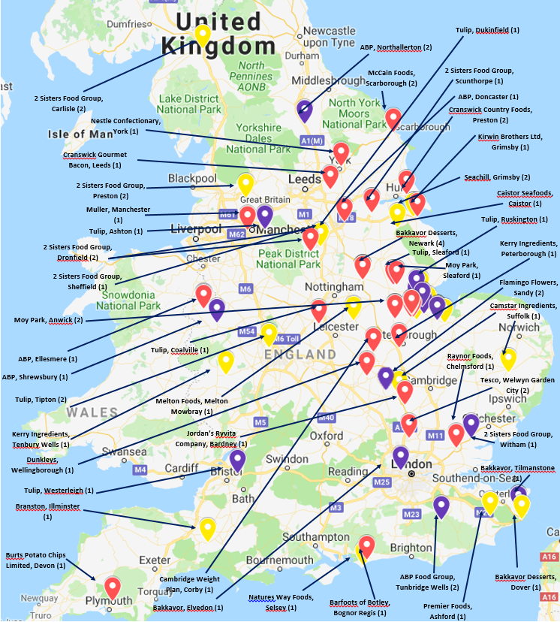
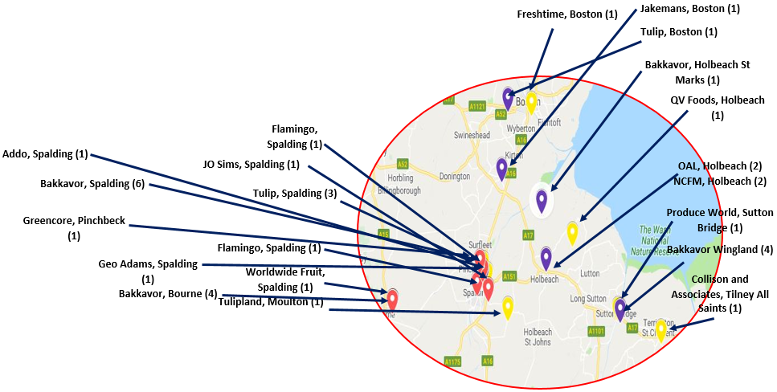
Higher and Degree Apprenticeship Participation 2018/19

Slide 6
The University picture
School | Standard | Level
NCFM | Process Operator/Food Technologist/Team leader/ Learning and Development Operations Manager/Manufacturing Manager Technical Professional Senior Leader | 2,3,5,6,7
Lincoln International Business School | Charted Manager and Senior Leader | 6 and 7
Nursing | Nursing Associate | 5
Engineering | Control/Technical Support Engineering Electrical/Electronic Technical Support Engineer | 6
Lincoln Academy of Learning and teaching | Academic Professional | 7

Slide 7
What's the national picture?
Apprenticeship numbers have fallen
Employers don’t understand
The health sector is the most popular
More women start apprenticeships than men
Male apprentices earn more
Apprenticeship achievements are up
More apprentices accessing Higher Education

Slide 9
Where are we now?
687 standards from level 2 to 7 listed, 169 in development or proposed – funding caps
Level 8 - Clinical academic professional and technical specialist in nuclear engineering, science and technology
94,000 fewer people were participating in an apprenticeship in 2017/18 than in 2016/17
In 2017/18, 814,800 apprenticeship (England), 375,800 starts and 276,200 achievements.

Slide 10
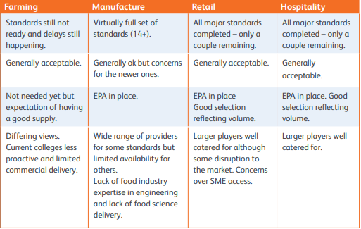
NSA Food and Drink Study 2019

Slide 11
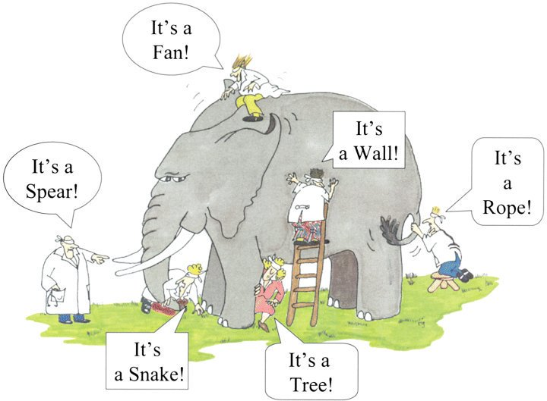
Challenges

Slide 12
Employer concerns
The sheer scale of payment
The perceived relevance of apprenticeships to deliver
The skills required by the business
The additional costs involved especially with recruitment
The devolved nations issue
20% backfill costs

Slide 13
Risky business
For providers…
Concerns range from a lack of standard uptake resulting in geographical wastelands, to selling of easier-to-deliver standards, irrespective of their suitability
Employers are often not always well enough informed and succumb to lowest common denominator apprenticeship standards

Slide 14
The future ……….

